Slide 1
Traffic Analysis

Slide 2
Problem Statement
The problem addressed in this report is the development of a model for performing traffic analysis using a dashcam video as input. Specifically, the report focuses on two key components of the model:
(1) The detection of vehicles using 3D bounding box techniques, and
(2) the recognition of number plates through optical character recognition (OCR) techniques.
The goal is to accurately identify and track vehicles in the video, as well as extract useful information from their number plates, in order to provide valuable insights for traffic analysis and management.

Slide 3
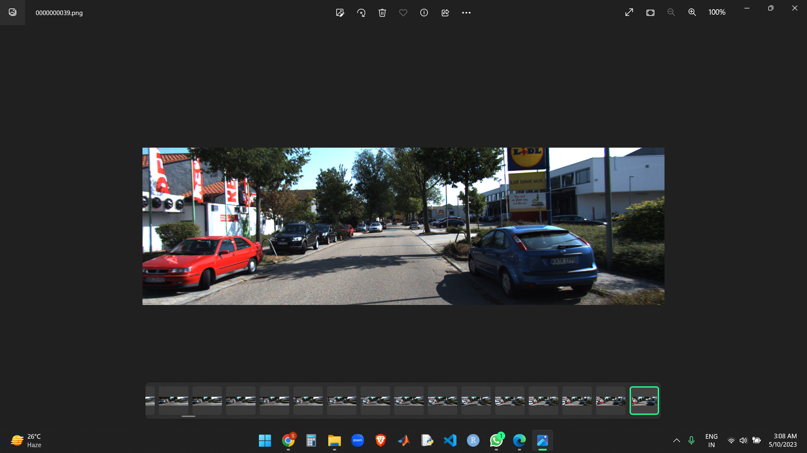
Dataset Description
Dataset used: KITTI Dataset: color images, Camera calibration matrix
Model used: vgg19 model (pretrained)

Slide 4
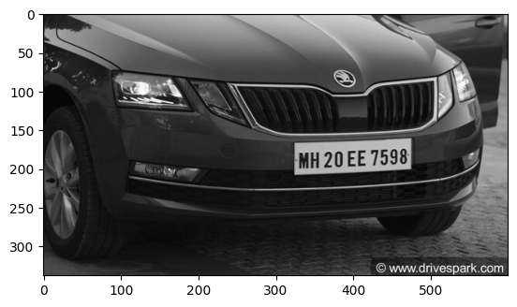
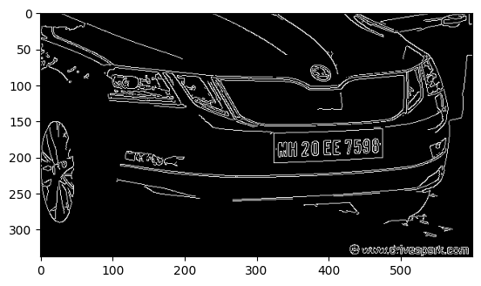
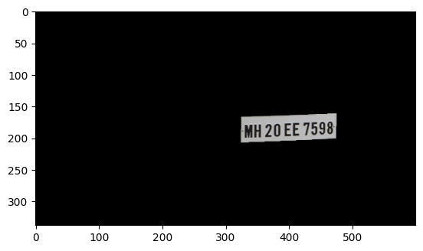
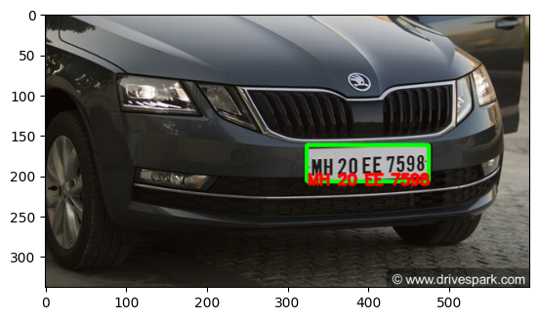
Methodolgy Masking for OCR
Original Image
Noise reduction and Canny Edge detection
Detected and perform OCR

Slide 5
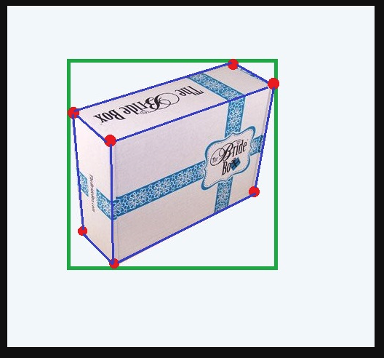
Methodology 3D Bounding Box
Assuming that the origin of the world coordinate frame is at the center of the 3D bounding box.
perspective projection of a 3D bounding box should fit tightly within its 2D detection window
The object has ~0 pitch and ~0 roll (valid for cars on the road)

Slide 6
Estimating Projection Matrix from World to Camera
Yolo Model to get 2D bounding box
ImageNet pre-trained VGG to get dimensions (length,height,width), local orientation and the confidence score associated with each orientation. For this we need to modify the FC layers.

Slide 7
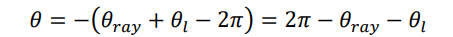
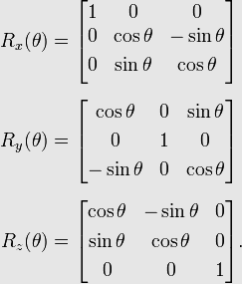
Estimating R
global orientation
Now find Rotation Matrix Rx(θ)

Slide 8
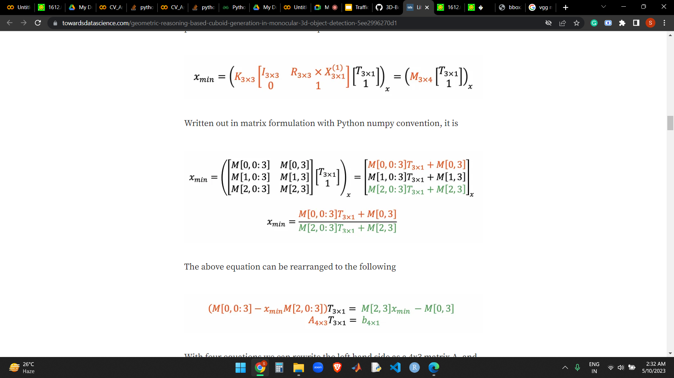
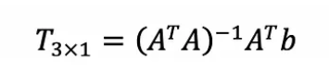
Estimating T
T is the translation vector from camera to world frame of reference.
We have 4 equations and 3 variables:(Tx, Ty, Tz).
Use linear-least fitting to solve for T using the formula:

Slide 9
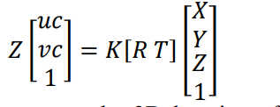
Project points onto the Image Plane
We know 8 corners of bounding box in world co-ordinate frame , project these points onto the image plane to get 3 d bounding box

Slide 10
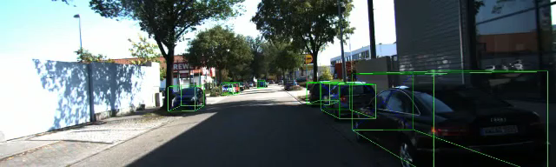
Results

Slide 11
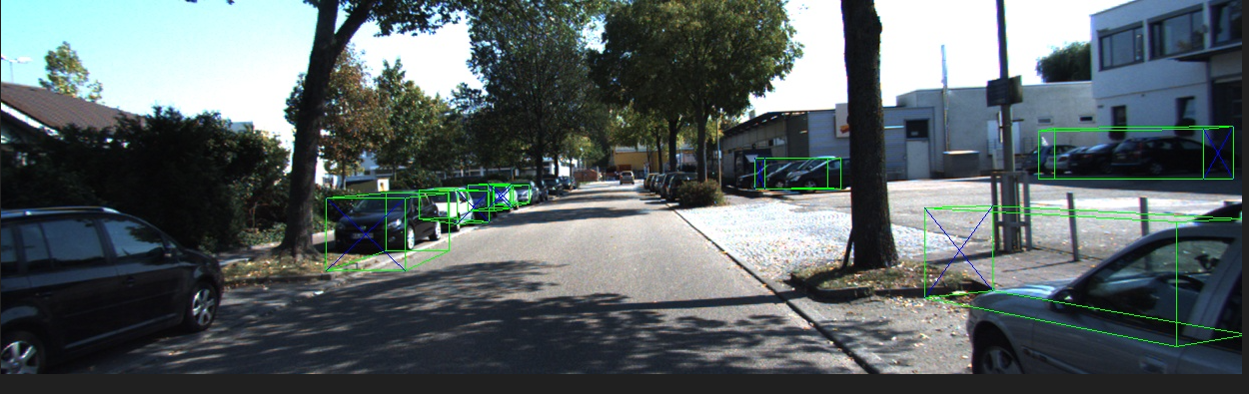
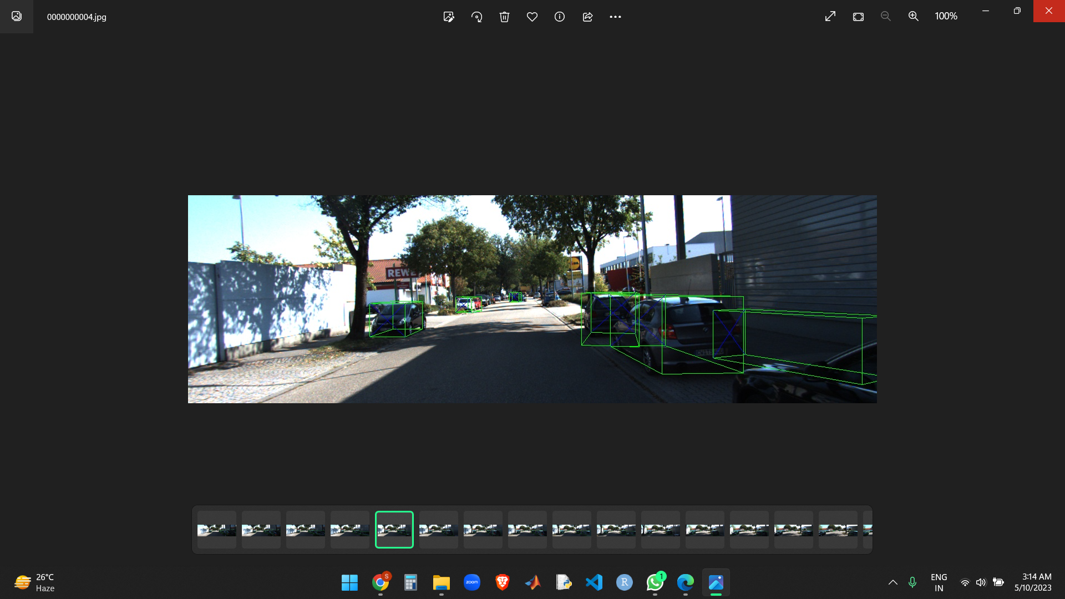
Failure
Bounding Box not detected
Bounding Box not accurate

Slide 12
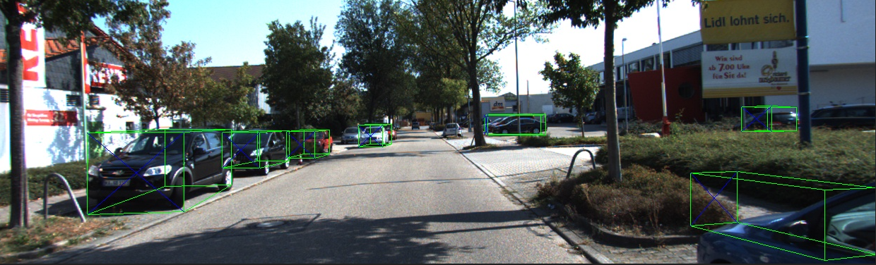
Bounding Box not accurate
Notes:
Occlusions: When an object is partially or fully occluded by another object in the scene, it becomes challenging to detect the 3D bounding box accurately. This problem is especially prevalent in crowded scenes, where multiple objects can occlude each other.
Lighting conditions: Poor lighting conditions, such as low light or glare, can make it challenging to detect 3D bounding boxes accurately. This is because the algorithm relies on identifying the edges and corners of the object to define the box, which can be challenging in low light.

Slide 13
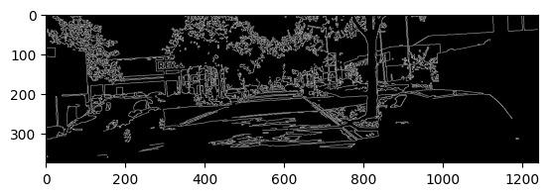
Failure

Slide 14
References
3D Bounding Box Estimation Using Deep Learning and Geometry: https://arxiv.org/pdf/1612.00496v1.pdf
3D Bounding Box Estimation for Autonomous Vehicles by Cascaded Geometric Constraints and Depurated 2D Detections Using 3D Results: https://arxiv.org/ftp/arxiv/papers/1909/1909.01867.pdf
https://towardsdatascience.com/geometric-reasoning-based-cuboid-generation-in-monocular-3d-object-detection-5ee2996270d1

